Slide 1

EXPLORING
STEAM
JING TANG

Slide 2
CONTENT
Data Pre-Processing
Exploratory Data Analysis
Benford Analysis
Text Mining & Sentiment
1
2
3
4

Slide 3
What is STEAM?
DEFINITION
Steam is a digital distribution platform developed by Valve Corporation for purchasing and playing video games. Steam offers digital rights management (DRM), matchmaking servers, video streaming, and social networking services. Steam provides the user with installation and automatic updating of games, and community features such as friends lists and groups, cloud saving, and in-game voice and chat functionality.
PERFORMANCE
The Steam platform is the largest digital distribution platform for PC gaming, estimated in 2013 to have 75% of the market space. By 2017, users purchasing games through Steam totaled roughly US$4.3 billion, representing at least 18% of global PC game sales.By early 2018, the service had over 150 million registered accounts with a peak of 18.5 million concurrent users online.
More info of STEAM at
https://en.wikipedia.org/wiki/Video_streaming

Slide 4
Chapter 1
Data Pre-Processing

Slide 5
DATA RESOURCE
Steam Spy
Link:
https://steamspy.com/
Steam DB
Link:
https://steamdb.info/apps/page1/
Steam Charts
Link:
https://steamcharts.com/
Steam
Link:
https://store.steampowered.com/stats/

Slide 6
TWO STEPS:
1.SCRAMPING RAW DATA
2.DATA CLEANING

Slide 7
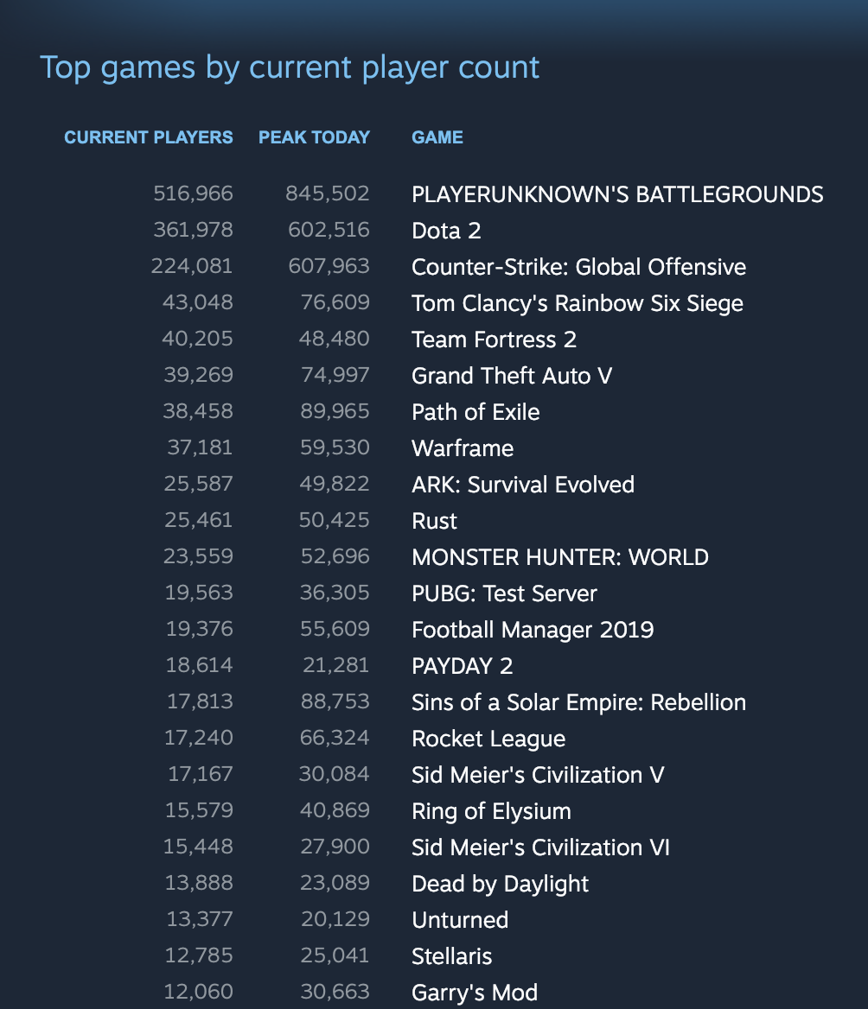
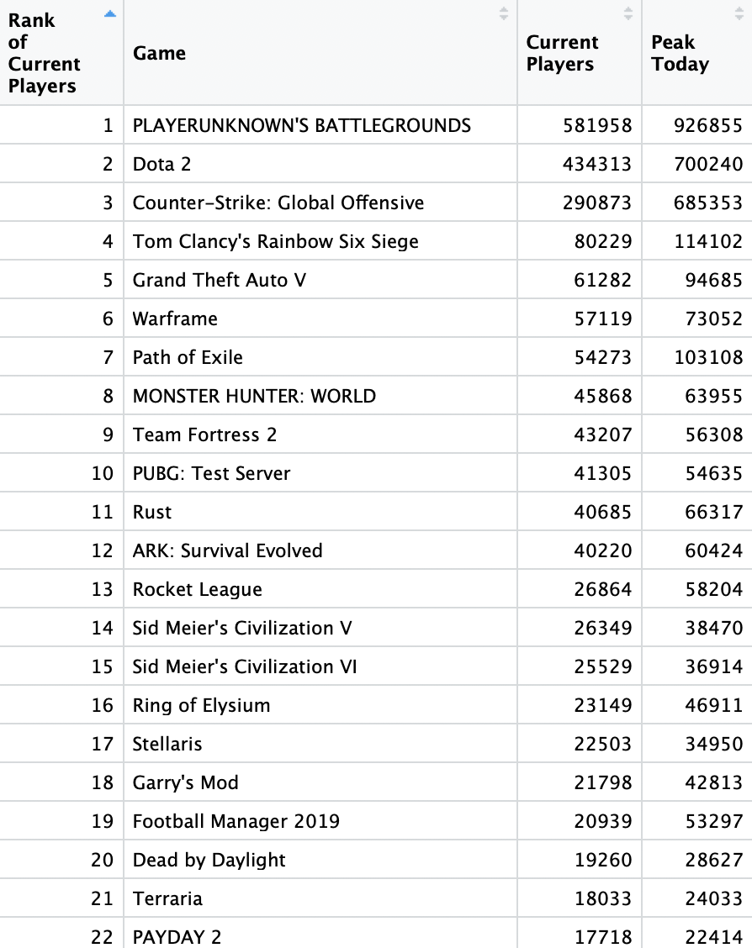

Slide 8
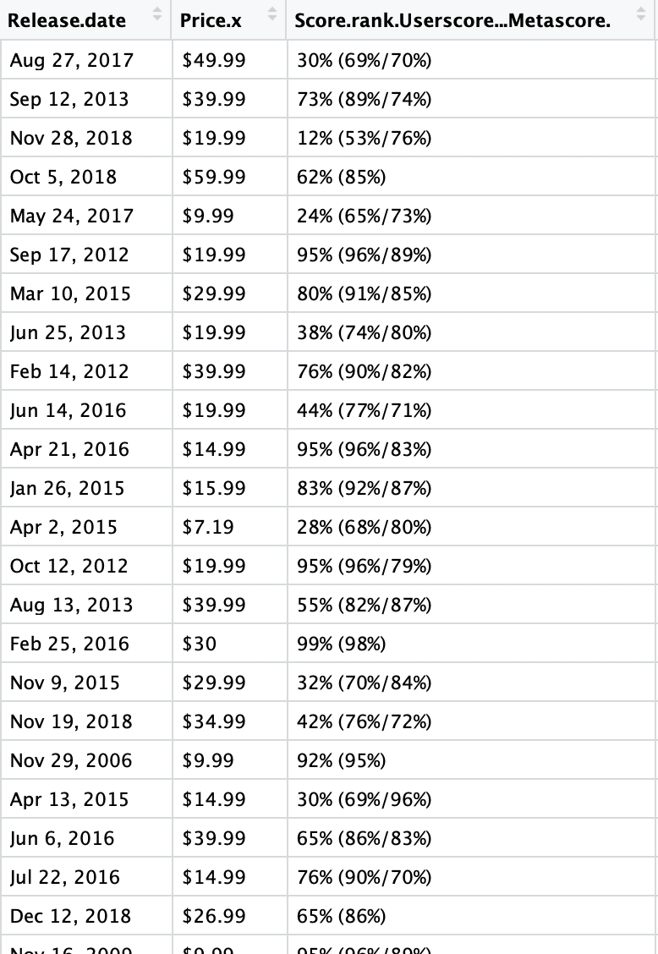
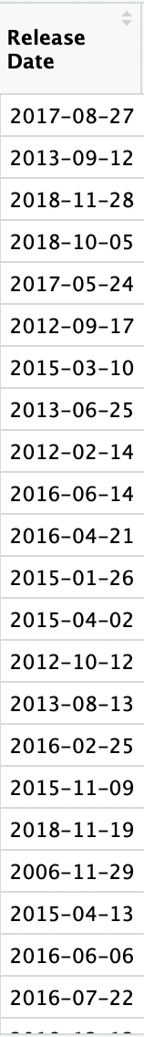
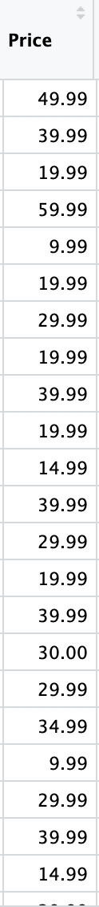
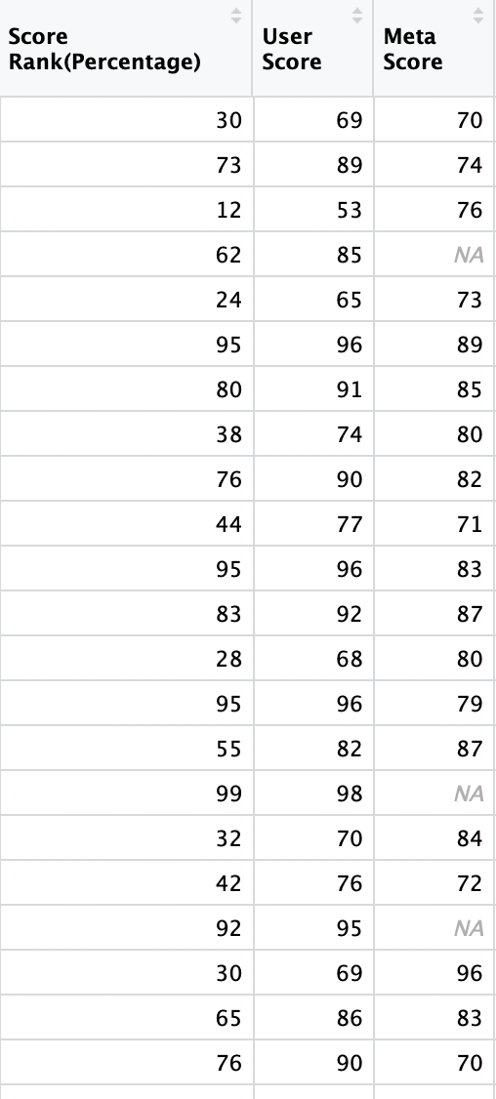

Slide 9
Chapter 2
Exploratory Data Analysis

Slide 10
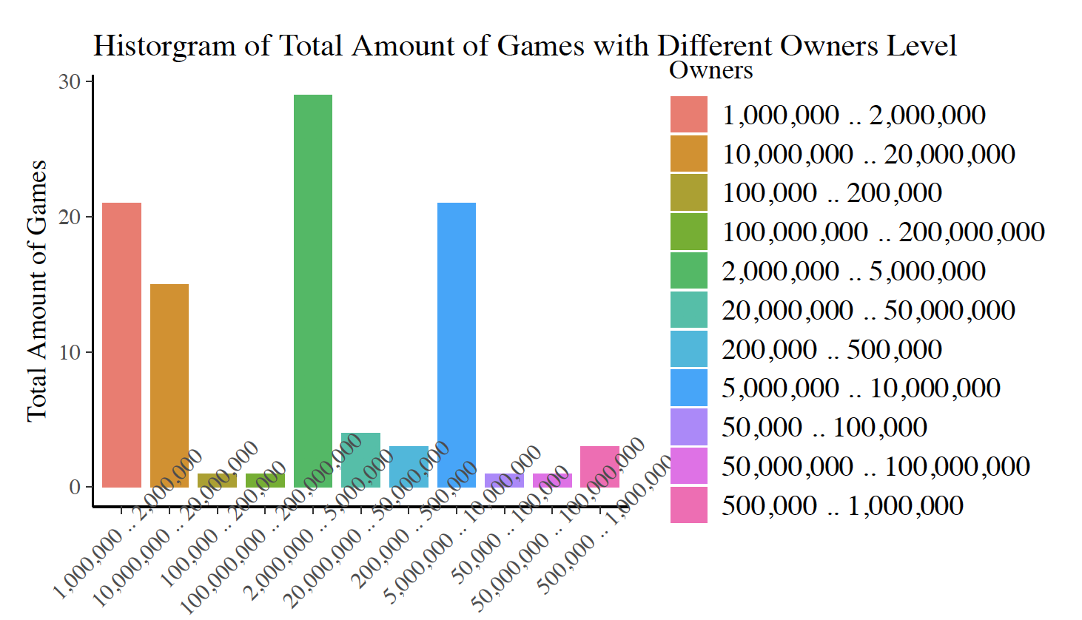
OWNERS
LEVEL
Popular games drive people pay more time on are either have tons of owners or have less owners but attract each owner to spent more time on it.

Slide 11
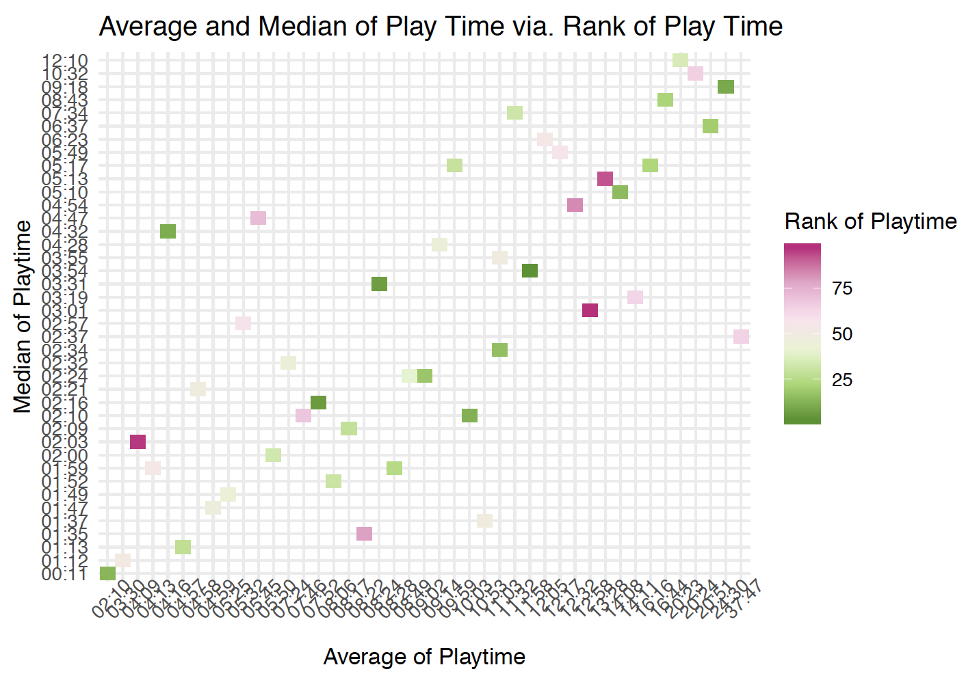
PLAY TIME
Even though the average and median play time of some games are low, the rank of total playtime is still high

Slide 12
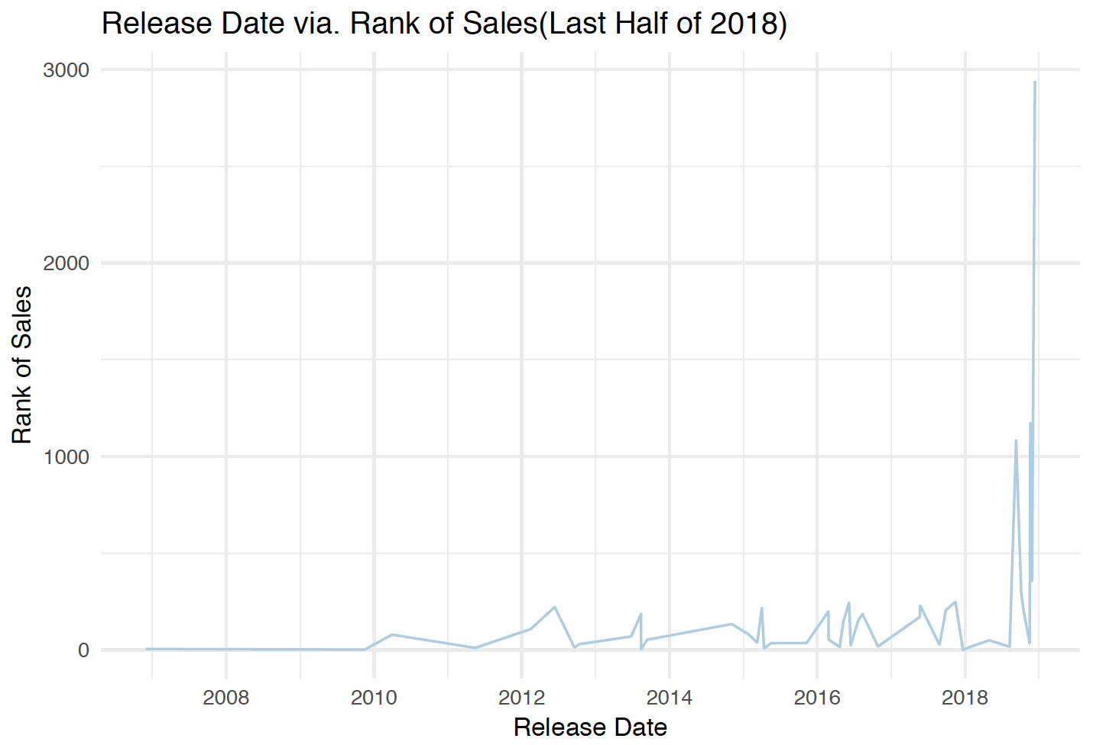
SALES
&
RELEASE DATE
The best seller among games are usually release recently.
For users, latest games can keep novelty and no one would like to play a game with pixels

Slide 13
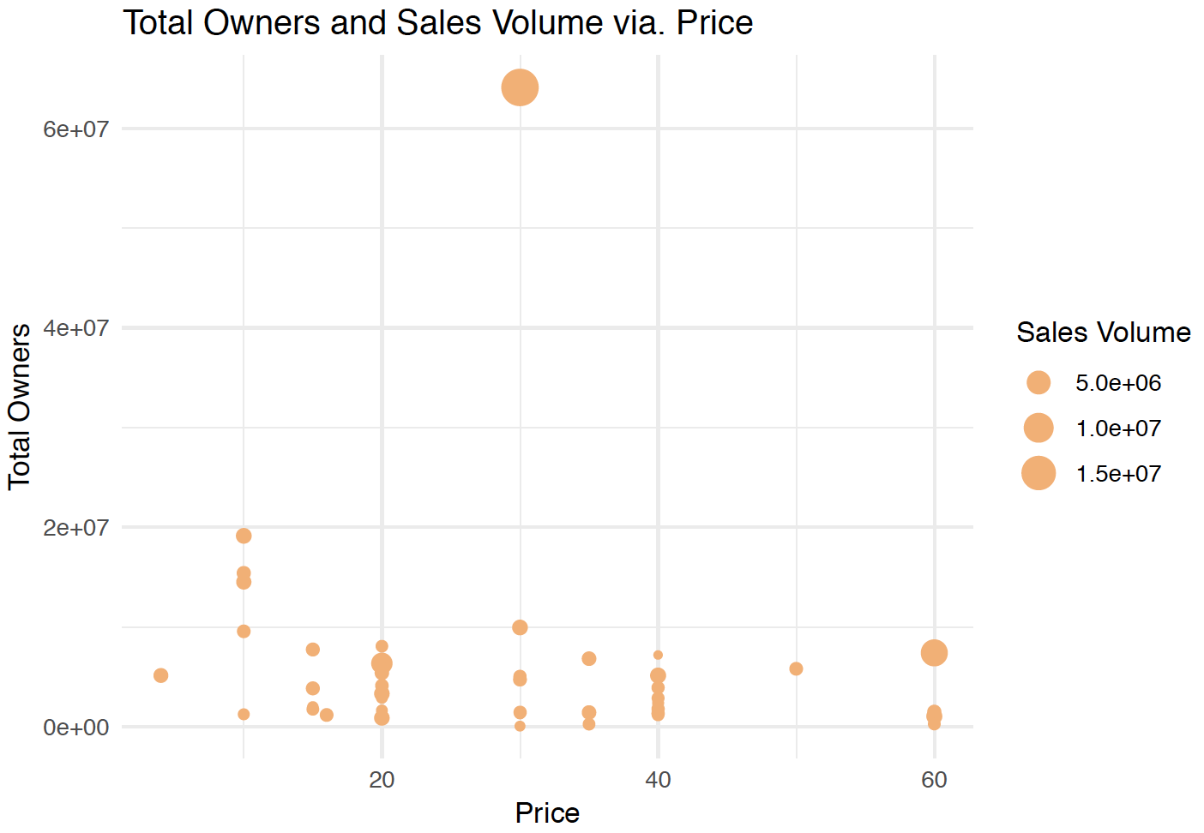
SALES VOLUME
&
PRICE
The best seller is actually positioning the price of its produce at average level which can be accepted by most of people

Slide 14

Chapter 3
Benford Analysis

Slide 15

BENFORD’S LAW
Benford's law, also called Newcomb-Benford's law, law of anomalous numbers, and first-digit law, is an observation about the frequency distribution of leading digits in many real-life sets of numerical data. The law states that in many naturally occurring collections of numbers, the leading significant digitis likely to be small.
More info of Benford’s Law at
https://en.wikipedia.org/wiki/Benford%27s_law

Slide 16
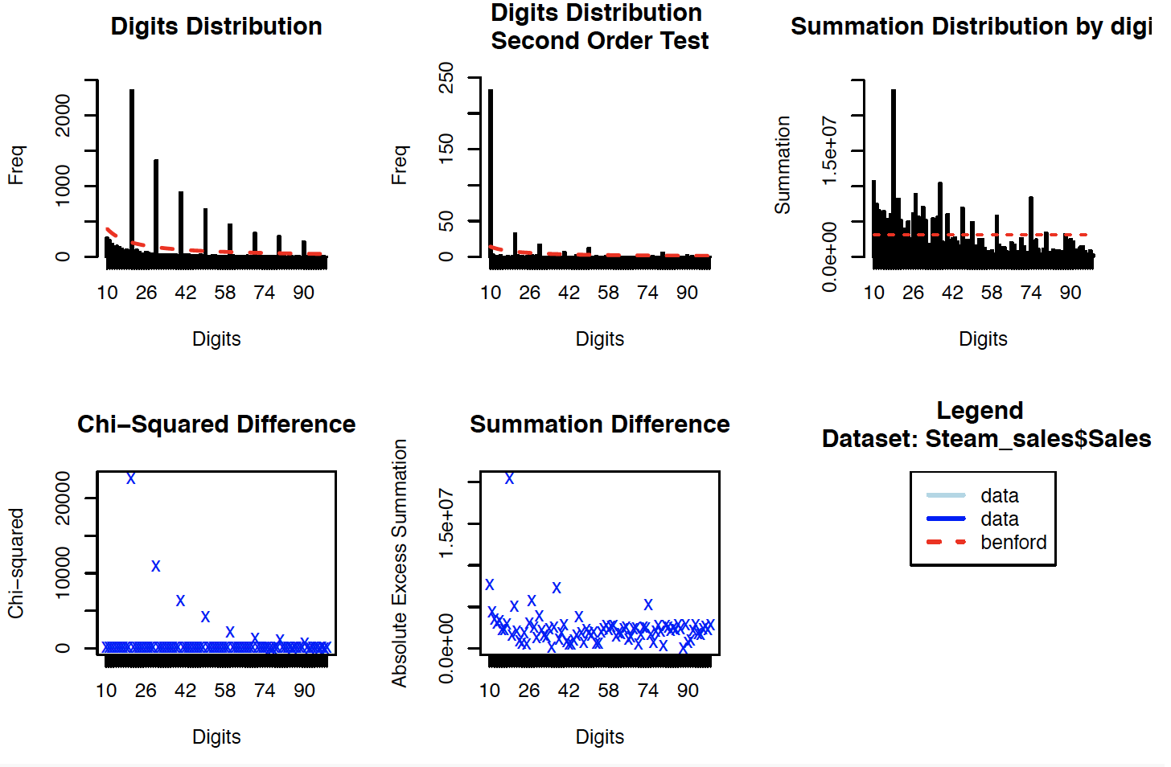
RESULT OF BENFORD ANALYSIS
Number | 2000 | 3000 | 4000
Duplicates | 2271 | 1314 | 875

Slide 17
Chapter 4
Text Mining
&
Sentiment Analysis

Slide 18
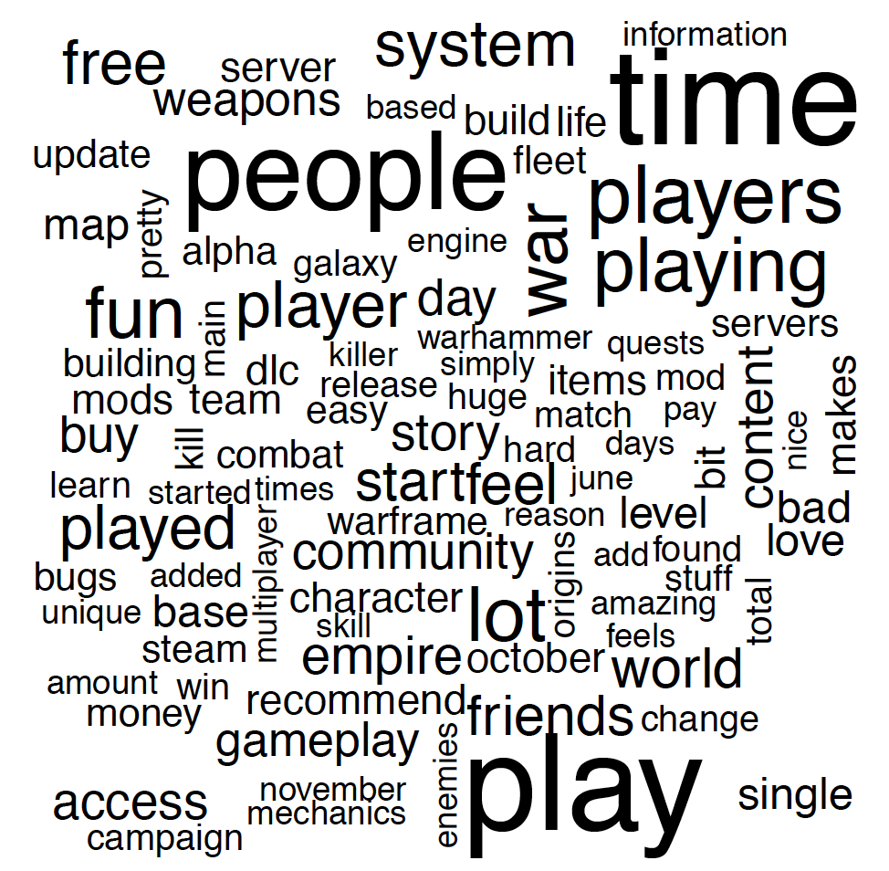
WORD CLOUD OF ALL REVIEWS
(TOP 100)

Slide 19
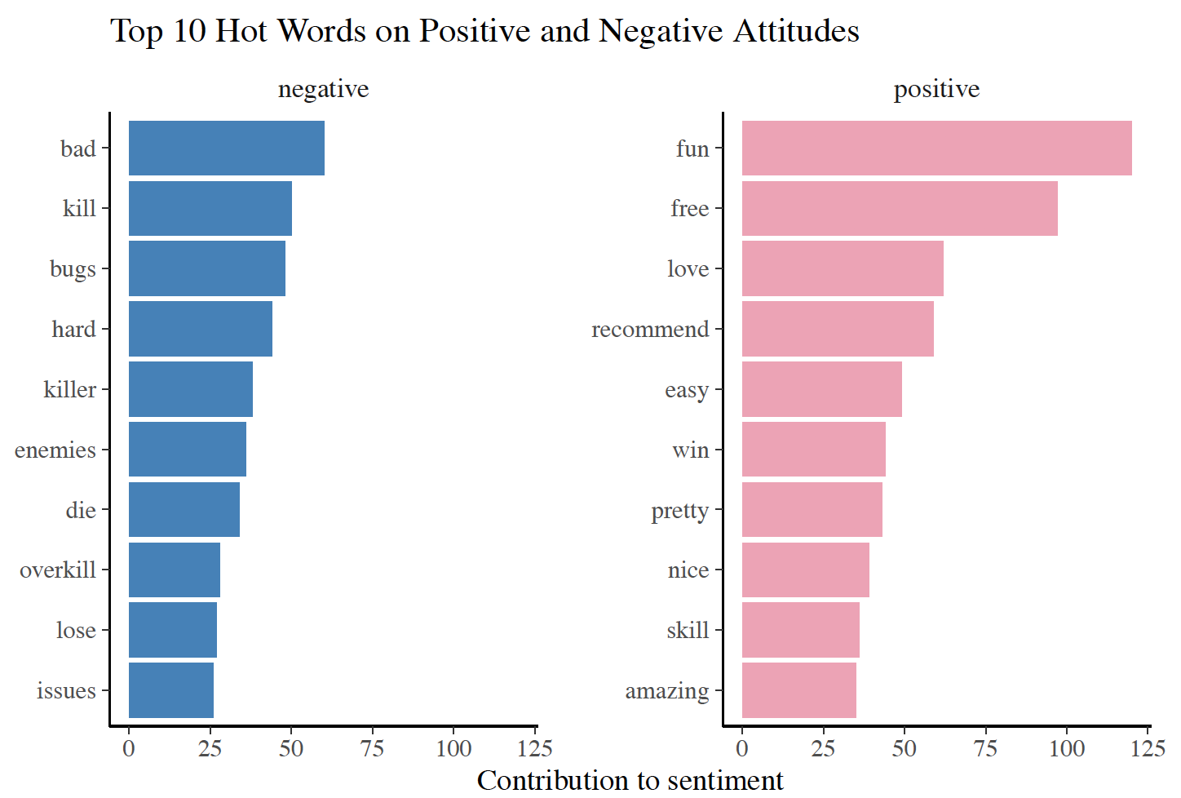
TOP 10 WORDS IN POSITIVE & NEGATIVE
ATTITUDES
“bing” dictionary may be not a good choice of sentiment analyzing games
Actual negative emotions caused by bugs and other issues

Slide 20
THANKS!
Any questions?
You can find me at jingtang@bu.edu

